Slide 1
OCSSD in FreeBSD Arka Sharma Amit Kumar Ashutosh Sharma
OCSSD in FreeBSD
Arka Sharma Amit Kumar Ashutosh Sharma

Slide 2
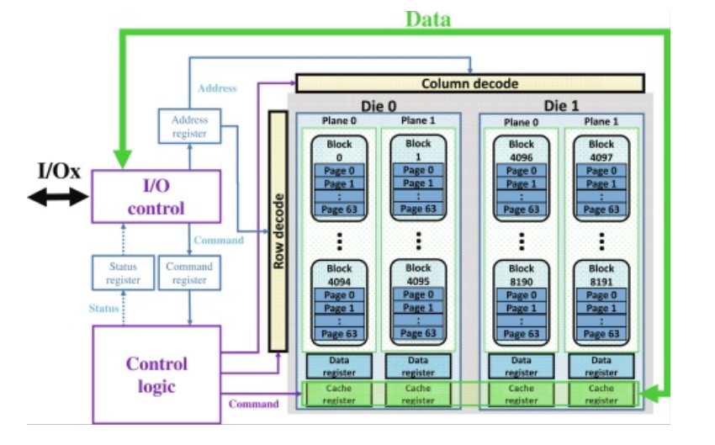
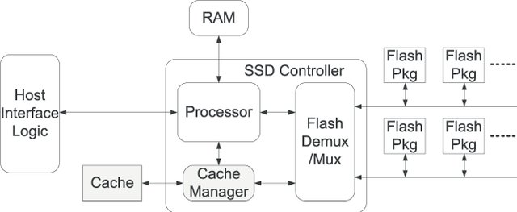
Traditional Architecture
SSD Architecture
NAND Organization
https://ars.els-cdn.com/content/image/1-s2.0-S0065245819300117-f01-10-9780128171578.sml
https://www.researchgate.net/profile/Vikram-Narayana/publication/221150993/figure/fig2/AS:394151314116614@1470984404449/Diagram-of-SSD-Internal-Architecture-with-the-Incorporated-Cache_W640.jpg

Slide 3
Characteristics/Limitations of Flash storage
Reads/Writes are done in a page granularity.
Once a page is written it can’t be overwritten until erase is performed.
Erase can be done in a block granularity.
Flash blocks have a limit on number of erase operations.
As blocks are erased through SSD’s lifetime after a point data corruptions, program failures, erase failures start appear.

Slide 4
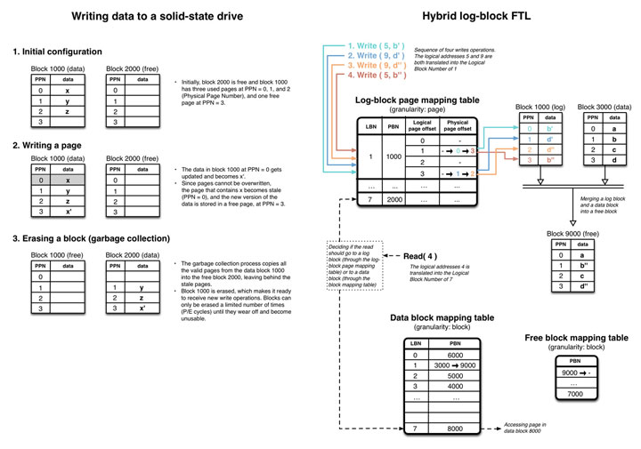
Flash Translation

Slide 5
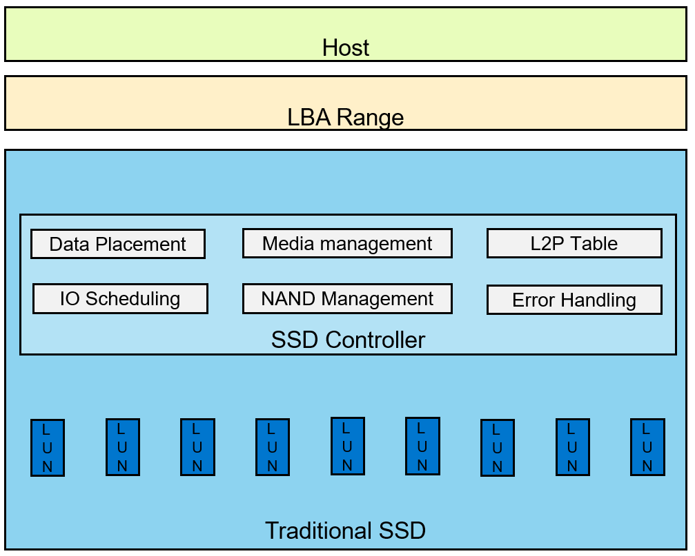
Shortcomings of traditional SSD’s
Shortcomings of traditional SSD’s
Existing traditional SSD based data storage solution lacks the fine control over I/O latencies and data placement.
The SSDs own the full control of data placement, device cache and L2P map management,
Requires a high computation and memory recourses on SSD controllers, which makes SSDs costlier.
Other well-known shortcomings like log-on-log, large tail-latencies , and resource underutilization.
To address the above listed problems OCSSD specification was introduced (http://lightnvm.io/docs/OCSSD-2_0-20180129.pdf), we implement a host based FTL in FreeBSD conforming to this specification.
The following paper discusses above issues as well as LightNVM in Linux which has inspired our work.
https://www.usenix.org/system/files/conference/fast17/fast17-bjorling.pdf
The following paper discusses a method to address the tail latency issue in a different way.
https://www.bsdcan.org/2015/schedule/attachments/310_iosched-v3.pdf

Slide 6
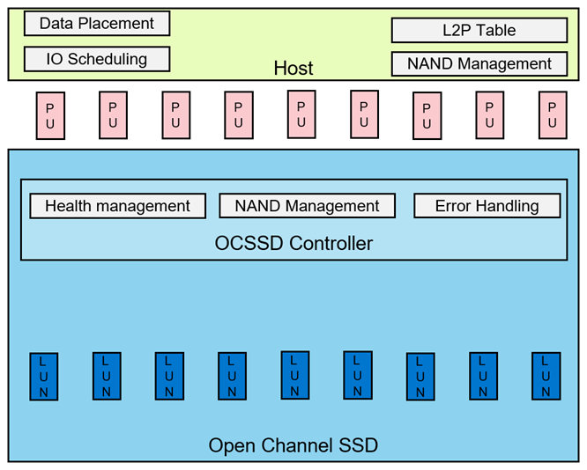
Solution:
NAND management can be a shared responsibility for both host and SSD.
SSD’s manage error detection and correction and NAND statistics.
Flash Translation Layer is implemented on host side.
Allows host to have better control over data placement and predicable I/O latency
Use OCSSD’s Physical Page Address I/O interface that exposes SSD parallelism and storage media characteristics.
As of now we have made a POC using QEMU FreeBSD 12.1 host running a QEMU OCSSD NVMe device.

Slide 7
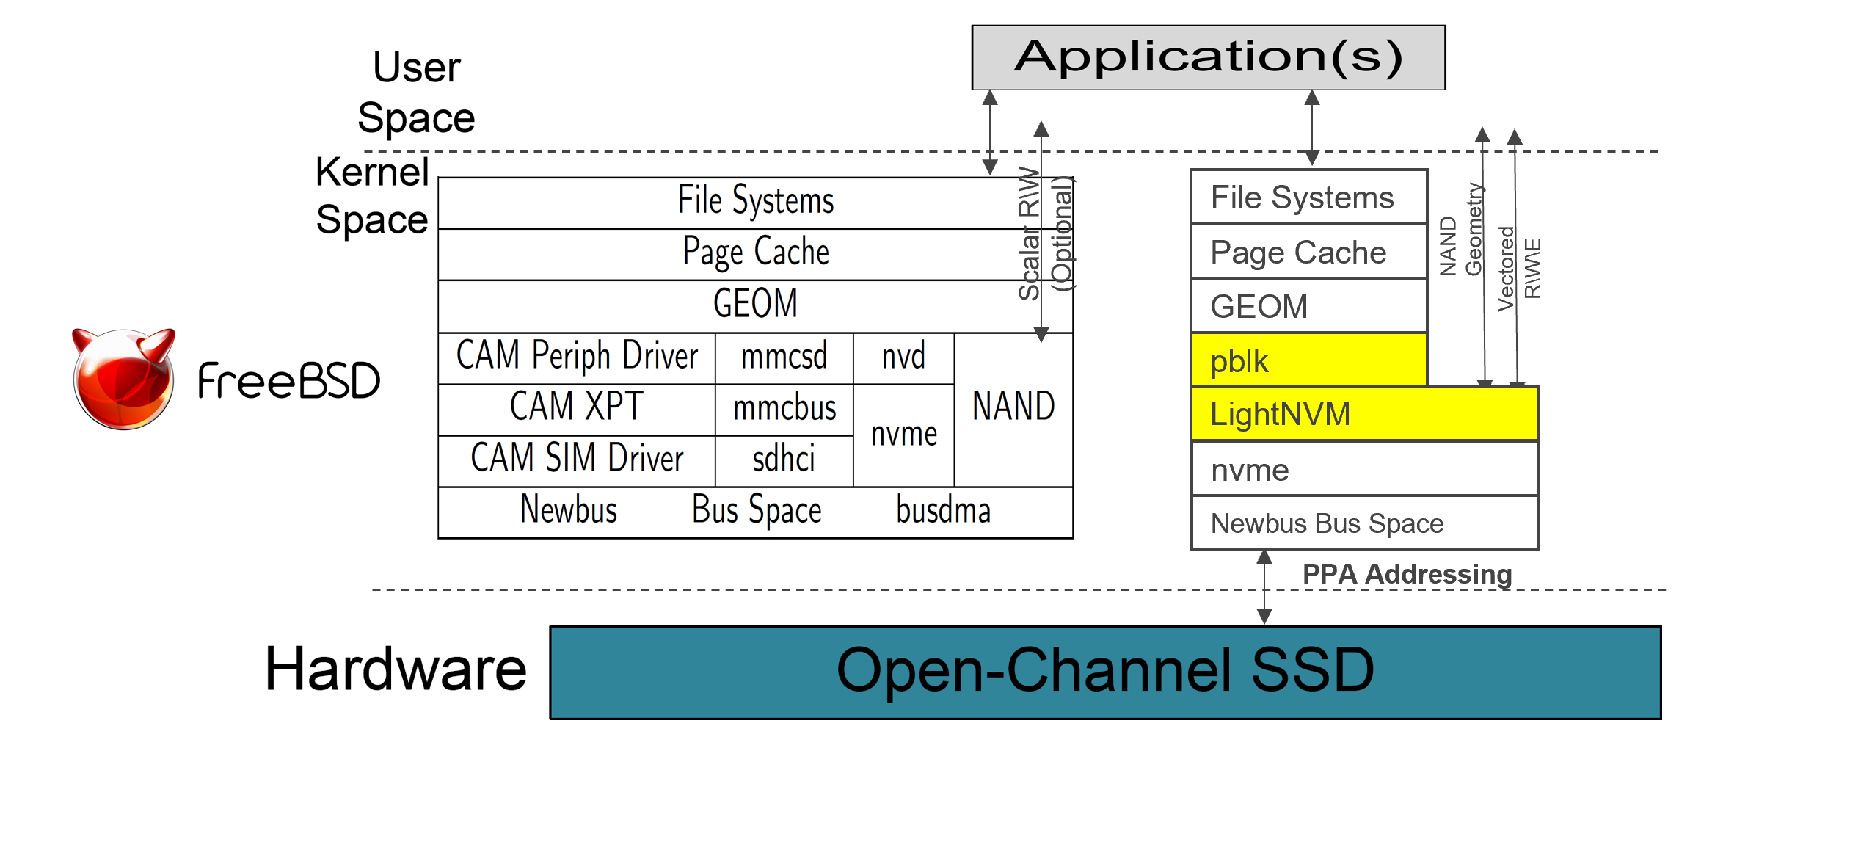
IO Stack

Slide 8
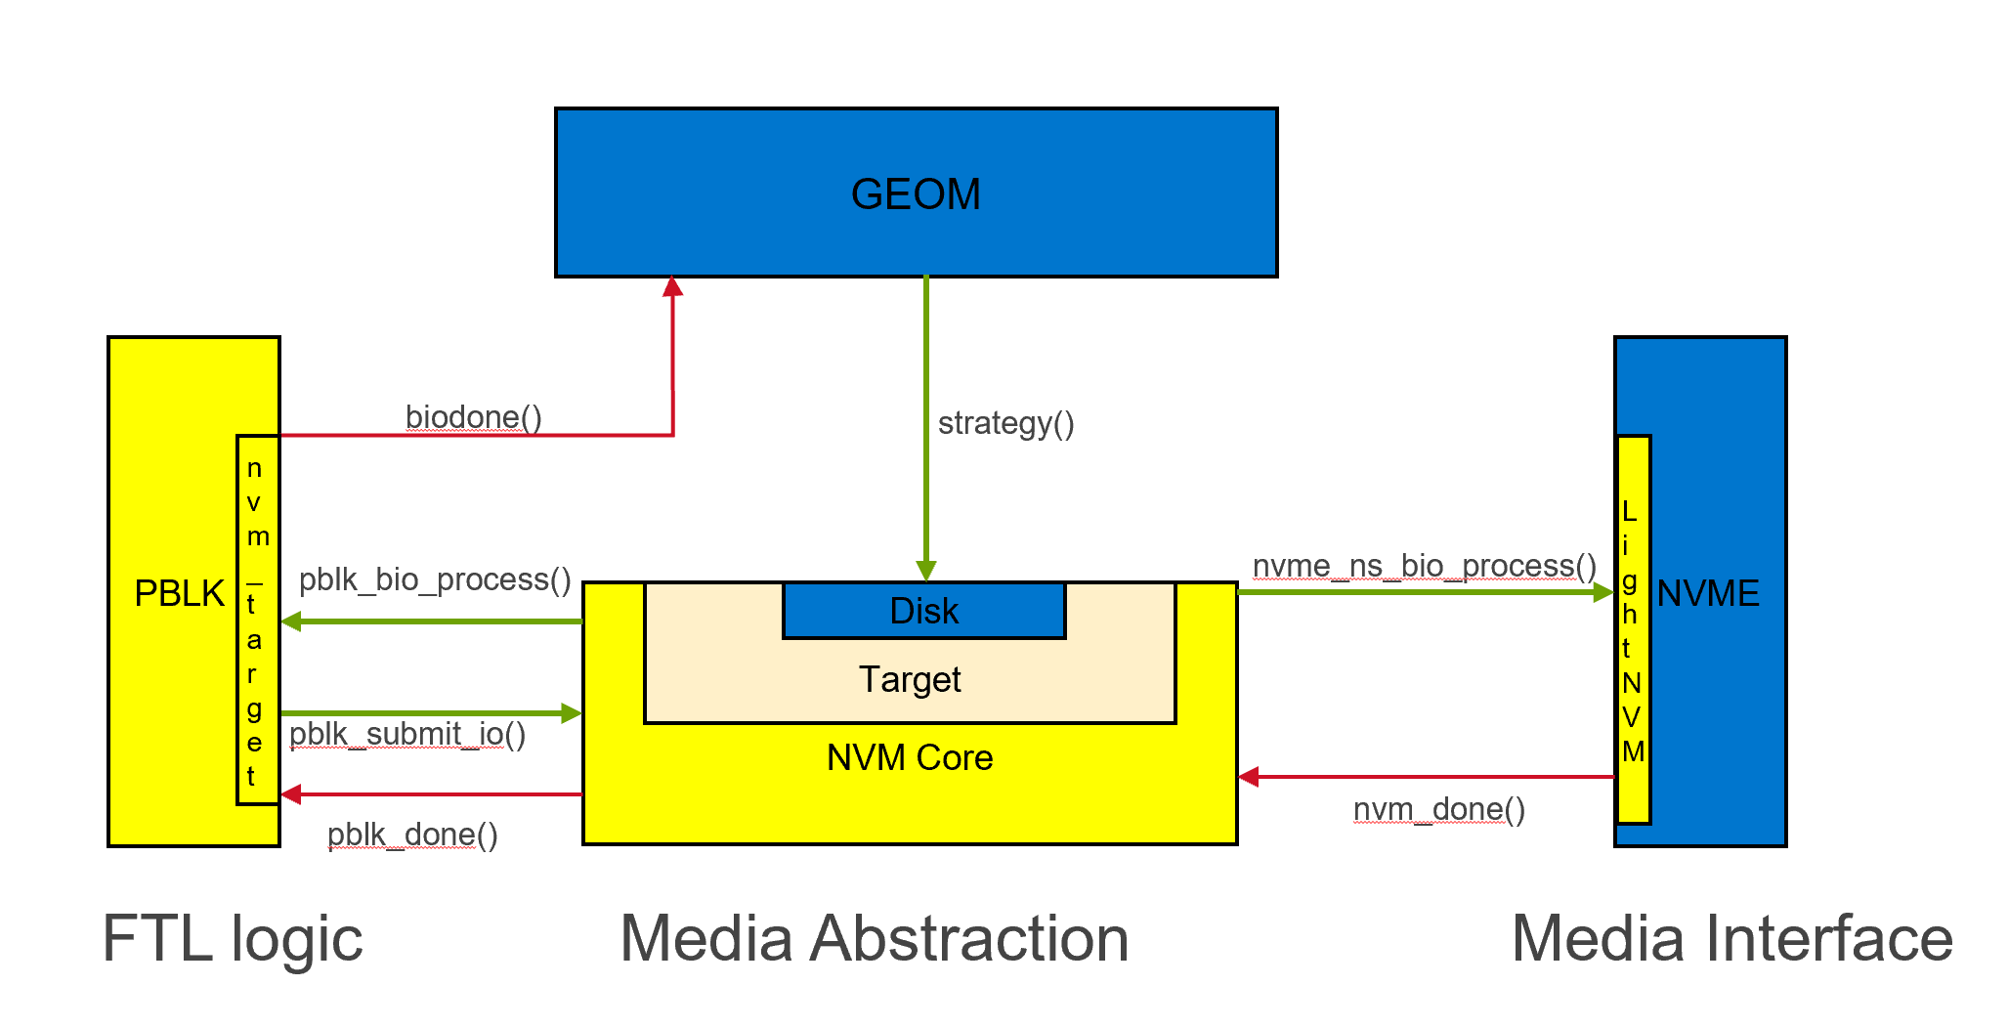
I/O Path

Slide 9
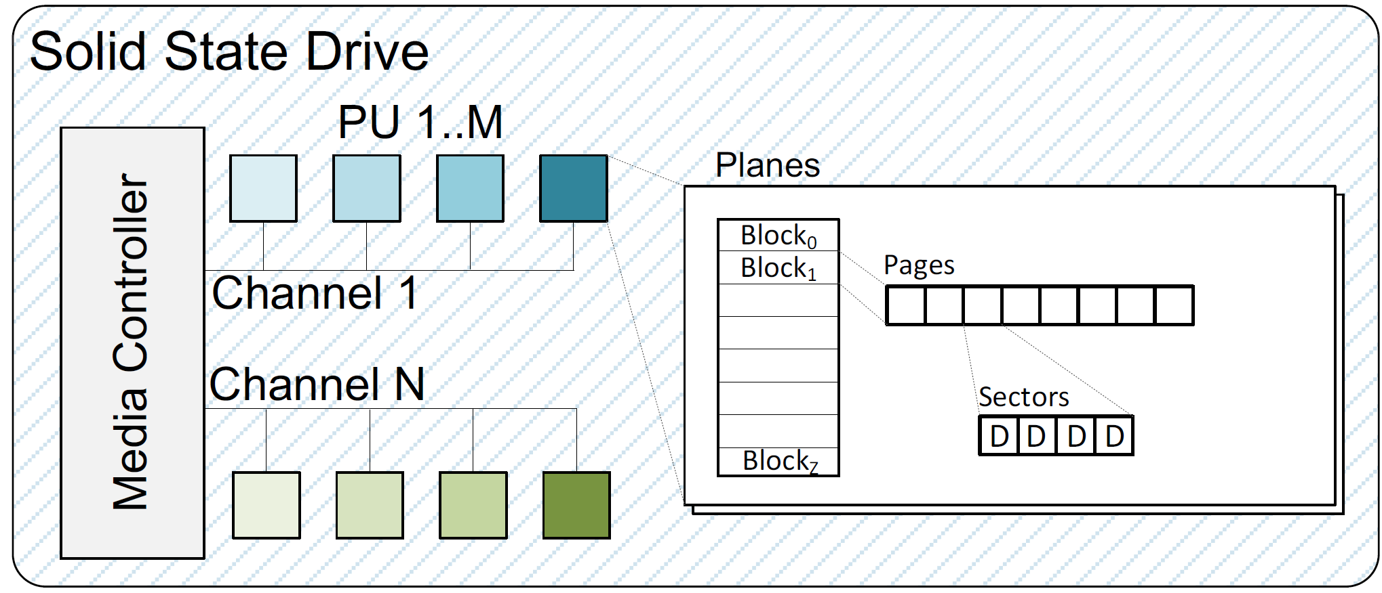
Physical Address Representation
Channels -> Parallel Units -> Planes -> Blocks -> Pages -> Sectors
http://lightnvm.io/docs/OCSSD-2_0-20180129.pdf
https://www.usenix.org/sites/default/files/conference/protected-files/fast17_slides_bjorling.pdf

Slide 10
Future Work
Complete garbage collection path.
Performance analysis with traditional NVMe SSD.
Implementing FTL as geom class.
Moving FTL logic to the user space.
Lessons learned
Familiarization with I/O flow in FreeBSD.
Got to do hands on kernel debugging.
Got overview of topics like GEOM, bio, QEMU etc.

Slide 11
OCSSD demo in FreeBSD on QEMU

Slide 12
Thank You

