Slide 1
Everything you ever wanted to know about “hello, world”*
(*but were afraid to ask)
Brooks Davis
SRI International
September 24th, 2016
EuroBSDCon 2016

Slide 2
K&R: The C Programming Language
#include <stdio.h>
main()
{
printf("hello, world\n");
}
Notes:
From: The C Programming Language
First example in K&R with some ANSI improvements
Headers omitted from here on

Slide 3
K&R: The C Programming Language
#include <stdio.h>
void
main(void)
{
printf("hello, world\n");
}
Notes:
From: The C Programming Language
First example in K&R with some ANSI improvements
Headers omitted from here on

Slide 4
Today’s version
int
main(void)
{
const char hello[] =
“hello, world";
printf("%s %d\n", hello, 123);
return (0);
}
Notes:
A little more complicated, so we can cover varidac arguments

Slide 5
Minimal C version
void
main(void)
{
const char *hello[] =
"hello, world\n";
write(1, hello, sizeof(hello));
exit(0);
}
Notes:
A bare assembly version of this would tens of instructions

Slide 6
Minimal (MIPS) assembly version
.text
.global __start
.ent __start
__start:
li $a0, 1
dla $a1, hello
li $a2, 13
li $v0, 4
syscall # write(1, "hello, world\n", 13)
li $a0, 0
li $v0, 1
syscall # exit(0)
.end __start
.data
hello:
.ascii "hello, world\n"

Slide 7
Size comparison
Assembly
Compiles to 9 instructions
Stripped binary less than 1K
Mostly ELF headers, MIPS ABI bits
Minimal C
Stripped binary over 550K!
Mostly malloc() and localization

Slide 8
Program linkage
$ cc -static -o helloworld helloworld.o
$ ld -EB -melf64btsmip_fbsd -Bstatic \ -o helloworld /usr/lib/crt1.o \ /usr/lib/crti.o /usr/lib/crtbeginT.o \ -L/usr/lib helloworld.o \ --start-group -lgcc -lgcc_eh –lc --end-group \ /usr/lib/crtend.o /usr/lib/crtn.o
Notes:
Run with -### to see what cc really does

Slide 9
Compiler runtime support
File | Purpose
crt1.o | Contains __start() function which initializes process environment and calls main().
crti.o | Entry points for old style _init() and _fini() functions.
crtbegin.o crtbeginS.o crtbeginT.o | Declares .ctor and .dtor constructor and destructor sections. Declares functions to call constructors and destructors.
crtend.o | NULL terminates .ctor and .dtor sections.
crtn.o | Trailers for _init() and _fini() functions.
Built in gnu/lib/csu and lib/csu/ARCH.
Notes:
crtbegin variants are for dynamic executables, shared object/PIE executables, and static executables respectively.
See also https://dev.gentoo.org/~vapier/crt.txt

Slide 10
Execution lifecycle (notional)
waitpid()
fork()
execve()
write()
exit()

Slide 11
Execution lifecycle (static)
waitpid()
fork()
mmap()
mmap()
mmap()
exit()
break()
fstat()
ioctl()
execve()
munmap()
munmap()
write()
munmap()
sysarch()
issetgid()
readlinnk()

Slide 12
Code and images online
https://people.freebsd.org/~brooks/talks/eurobsdcon2016-helloworld
or
http://bit.ly/helloworld-eurobsd

Slide 13
execve()

Slide 14
exec_copyin_args()
Allocate memory
Copy in program path

Slide 15
sys_execve()

Slide 16
kern_execve()
namei() Resolve path
exec_check_permissions() Check that the file has the right permissions and open it.
exec_map_first_page() Map the header into kernel memory.

Slide 17
exec_elf64_imgact()

Slide 18
exec_new_vmspace()
vm_map_stack() Map a stack into the addres space
pmap_remove_pages() vm_map_remove() Evict all page mappings from the address space
Stack
Notes:
Process differs slightly for threaded programs.

Slide 19
exec_elf64_imgact()
elf_load_section() Map .text section into memory
elf_load_section() Map .data section into memory and create bss
.text
.data
bss
Stack

Slide 20
kern_execve()
exec_copyout_strings() elf64_freebsd_fixup() Copy argv, envp, etc to the stack and adjust stack pointer.
exec_setregs() Set initial register context to enter __start().
.text
.data
bss
Stack
Notes:
The rest is cleanup

Slide 21
sys_execve()
.text
.data
bss
Stack

Slide 22
Returning to userspace
Stack is mapped into address space
Program is mapped into address space
Strings, argv, envp, signal handler, etc are on the top of the stack
Register state is set up to call __start()
.text
.data
bss
Stack

Slide 23
SCO i386 ABI stack
arg and env strings
argc
ELF auxargs
pagesizes
array
argv[]
environ[]
canary
rtld path
sigcode
ps_strings
SP
__start(char **ap, …) {
...
argc = * (long *) ap;
argv = ap + 1;
env = ap + 2 + argc;
...
Notes:
Arguments, environment, etc installed at the top of the stack.
Part of the ABI
Lots of implicit knowledge of layout.
No very capability-ish

Slide 24
__start()
Most cycles spent in malloc()
Notes:
NB: _start1() is the MIPS __start(). __start() is a realignment hack for CheriBSD.

Slide 25
__start() 1/2
void __start(char **ap)
{
int argc;
char **argv, **env;
argc = * (long *) ap;
argv = ap + 1;
env = ap + 2 + argc;
…

Slide 26
__start() 2/2
…
handle_argv(argc, argv, env);
_init_tls();
handle_static_init(argc, argv, env);
exit(main(argc, argv, env));
}
Set environ and __progname variables.
Notes:
handle_argv sets “environ” and “__progname”
handle_static_init() calls .pre_init_array, _init(), and .init_array constructors and installs finalize() handler for destructors

Slide 27
_init_tls()
Most cycles spent in malloc()

Slide 28
_init_tls()
Find the ELF auxargs vector
Elf_Addr *sp;
sp = (Elf_Addr *) environ;
while (*sp++ != 0)
;
aux = (Elf_Auxinfo *) sp;

Slide 29
_init_tls()
Find the ELF auxargs vector
Use that to find the program headers
Use those to find the PT_TLS section (initial values)
Call __libc_allocate_tls() (as _rtld_allocate_tls())
Allocates space
Copies initial values
Set the TLS pointer
Uses JEMalloc, but JEMalloc uses TLS!

Slide 30
__start() 2/2
…
handle_argv(argc, argv, env);
_init_tls();
handle_static_init(argc, argv, env);
exit(main(argc, argv, env));
}
Calls constructors and registers destructors. Four types supported:
.pre_init_array section
_init() function
.ctors section (via _init())
.init_array section
Notes:
handle_argv sets “environ” and “__progname”
handle_static_init() calls .pre_init_array, _init(), and .init_array constructors and installs finalize() handler for destructors

Slide 31
main()

Slide 32
vfprintf()

Slide 33
__get_locale()

Slide 34
vfprintf()

Slide 35
__vfprintf()

Slide 36
__vfprintf()
Look up decimal point string.
(“\n”)
(“%s”, hello)
(“ %d”, 123)

Slide 37
__sprint()
New-line character found.

Slide 38
__flush()
The actual call to write()

Slide 39
Hello World! 123

Slide 40
__start()
Notes:
NB: _start1() is the MIPS __start(). __start() is a realignment hack for CheriBSD.

Slide 41
exit()
Call destructors registered with atexit()
Flush any unflushed FILEs
Call _exit()

Slide 42
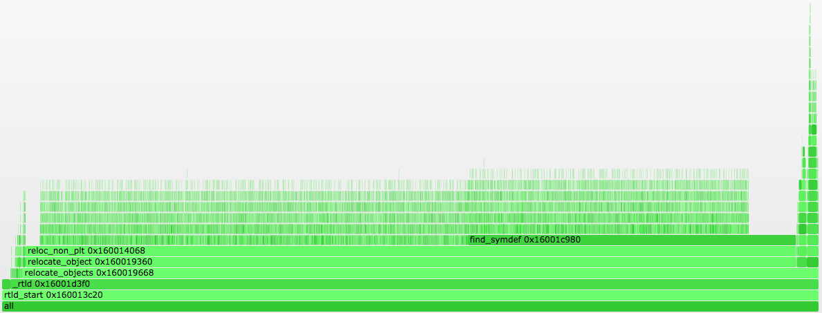
Dynamic binary
Load and relocate libc
_rtld_relocate_nonplt_self()
Rtld relocates itself
__start()
.text
.data
bss
rtld
libc
Stack

Slide 43
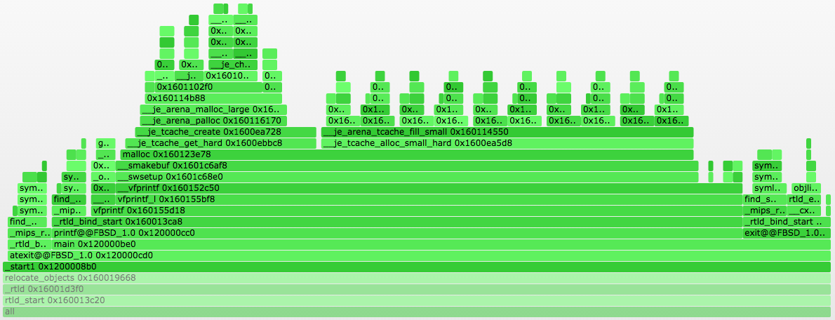
__start()

Slide 44
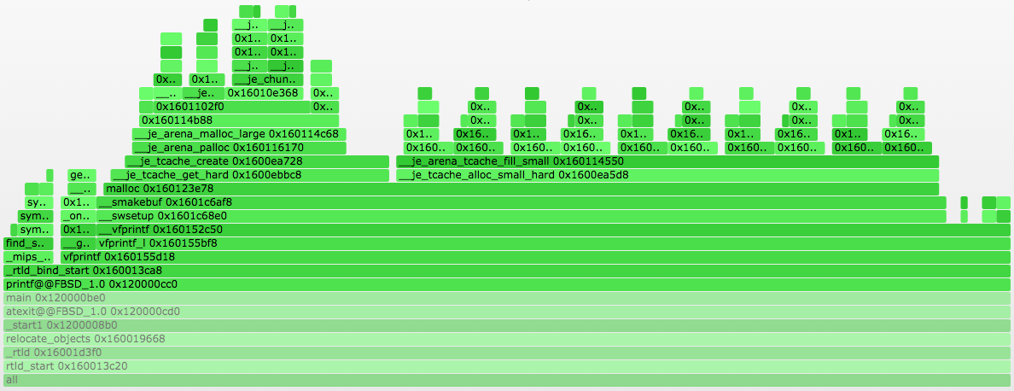
printf()

Slide 45
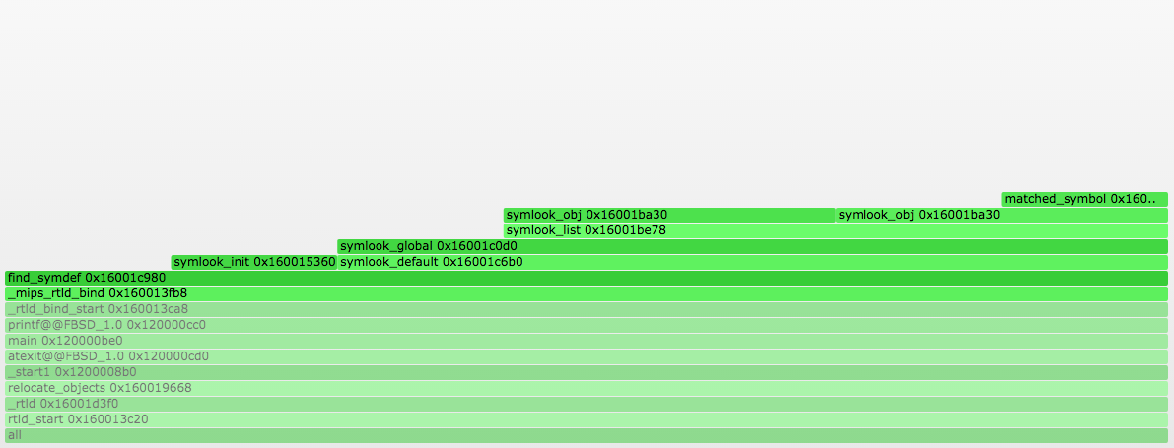
_mips_rtld_bind()

Slide 46
printf()

Slide 47
Feedback re quested
Was the talk interesting and/or helpful?
What didn’t make sense?
What would you like have learned more (or less) about?
brooks.davis@sri.com

